Slide 1
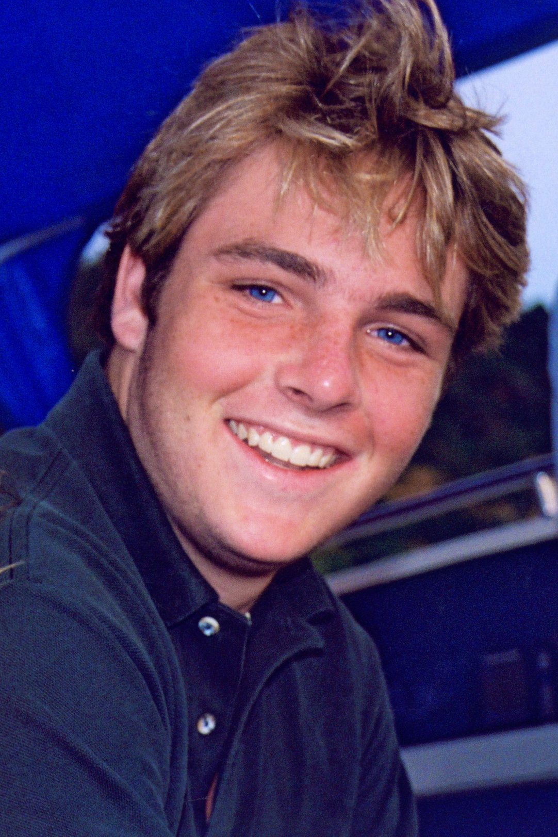
National GORDIEday
Alcohol & Hazing
Gordie Bailey
The Gordie Center
University of Virginia
Notes:
The facilitators should introduce themselves, welcome and thank everyone for attending.
Give some information about your personal connection to the issue and what brings you into the room.

Slide 2
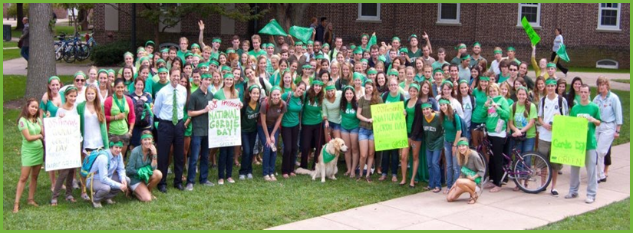
Notes:
National GORDIEday is celebrated every September on the Thursday of National Hazing Prevention Week, which is sponsored by Hazing Prevention.org.
It serves as a day of remembrance for Gordie Bailey, and a way to raise awareness about the dangers of hazing and alcohol overdose.

Slide 3
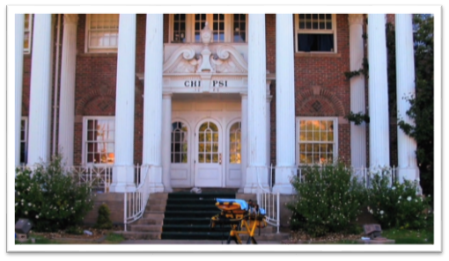
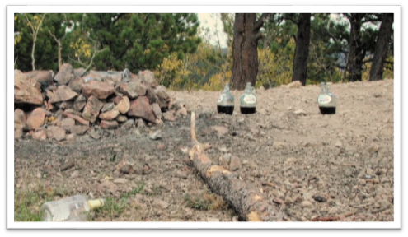
Gordie's Story
Notes:
On September 17, 2004, Lynn Gordon Bailey (Gordie) was found dead at the Chi Psi fraternity house at the University of Colorado Boulder.
The night before his death, Gordie and 26 other Chi Psi fraternity pledges were taken to a national forest where they sat around a campfire with 4 handles of whiskey and 6 large bottles of wine.
NOTE: Actual pictures of the camp site and the stretcher outside the fraternity house.

Slide 4
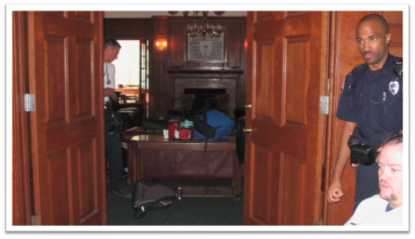
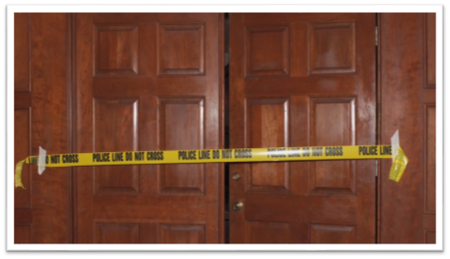
Gordie's BAC was .328
Notes:
When they arrived back at the Chi Psi house, Gordie was visibly intoxicated. His speech was slurred and he was having difficulty standing – he did not drink any more.
His brothers placed him on a couch in the library to “sleep it off” and returned to the party…but not before drawing all over his body with permanent marker.
Gordie was left for 10 hours before he was found dead the next morning, face down on the floor. No one called for help until it was too late.
Gordie’s Blood Alcohol Content (BAC) was 0.328 (more than 4 times the legal driving limit).

Slide 5
Gordie's death was entirely preventable.
Notes:
On average, there’s at least one hazing death every year in the United States. EACH ONE is completely preventable.
Gordie’s death could have been prevented at many different times the night he died.
Even if someone doesn’t die, the hidden psychological harm of hazing “traditions” can last a lifetime.
We want you to learn what you could do if you’re in a similar situation.

Slide 6
How do you define hazing?
Notes:
Gordie might not have consumed so much alcohol if the activity hadn’t also included hazing.
ASK → How would you define hazing?
Gather a few responses, using one of the formats below:
Use an online participant response systems (e.g., Mentimeter.com) to receive real-time responses and show them through your PowerPoint slides. A basic Mentimeter account is free.
Ask students to turn to a neighbor and share their thoughts, then ask for volunteers to share with the whole group. If delivering the program online, put students in breakout rooms, and ask for one person to submit a group response through chat once everyone returns to the main room.
Ask the entire group for ideas on what hazing is and invite students to share their thoughts. If delivering online, invite students to submit through chat.

Slide 7
Hazing is...
any activity that is expected
or required of someone
to join or maintain status within a
group that humiliates, degrades,
or risks emotional and/or physical harm,
REGARDLESS
of the person's willingness to participate.
Source: HazingPrevention.org
Notes:
Let’s make sure we all have a basic understanding of what hazing is:
There are 3 components:
Group context (related to joining or maintaining membership in a group)
Humiliating, degrading, or endangering behavior
Regardless of consent
When we ask students: “What do you notice, find interesting, or find confusing about this statement?”
They really focus on consent. That phrase: "regardless of a person’s willingness to participate.”

Slide 8
Hazing Signs: What to Do if You're Being Hazed
Notes:
Watch the Gordie Center one-minute video: Hazing Signs: What to Do if You're Being Hazed

Slide 9
How have you helped a friend in a problem situation?
Notes:
ASK → How have you helped a friend in a problem situation? We would love to hear how you have helped your peers in the past.
Gather a few responses, using one of the formats below:
Use an online participant response systems (e.g., Mentimeter.com) to receive real-time responses and show them through your PowerPoint slides. A basic Mentimeter account is free.
Ask students to turn to a neighbor and share their thoughts, then ask for volunteers to share with the whole group. If delivering the program online, put students in breakout rooms, and ask for one person to submit a group response through chat once everyone returns to the main room.
Ask the entire group for ideas on what hazing is and invite students to share their thoughts. If delivering online, invite students to submit through chat.
GOAL: show students they already use some forms of bystander intervention to protect their friends.

Slide 10
Hazing signs: Worried about a friend
Notes:
Watch the Gordie Center one-minute video: Hazing signs: Worried about a friend?

Slide 11
What makes it difficult to intervene in alcohol situations?
Notes:
ASK → What makes it difficult to intervene in alcohol situations?
Gather a few responses, using one of the formats below:
Use an online participant response systems (e.g., Mentimeter.com) to receive real-time responses and show them through your PowerPoint slides. A basic Mentimeter account is free.
Ask students to turn to a neighbor and share their thoughts, then ask for volunteers to share with the whole group. If delivering the program online, put students in breakout rooms, and ask for one person to submit a group response through chat once everyone returns to the main room.
Ask the entire group for ideas on what hazing is and invite students to share their thoughts. If delivering online, invite students to submit through chat.
Review their answers…validate.
Most groups will mention fear of getting in trouble and know knowing if a situation is truly an emergency.
Mention that marginalized groups may be more hesitant to call 911.

Slide 12
PUBS sign of alcohol overdose
Notes:
Watch the Gordie Center one-minute video: PUBS signs of alcohol overdose

Slide 13
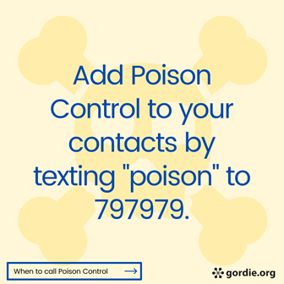
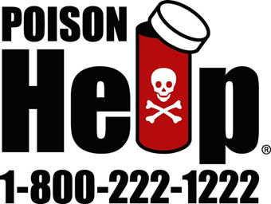
BAC can continue to rise even after someone passes out.
Notes:
Encourage audience to add the National Poison Control Hotline phone number into their phone contact list. Poison Control centers offer free, expert medical advice 24/7, and can provide advice on what to do if you are worried about a friend who has had too much too drink.

Slide 14
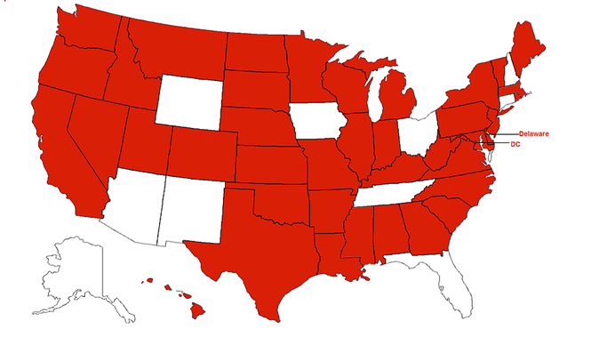
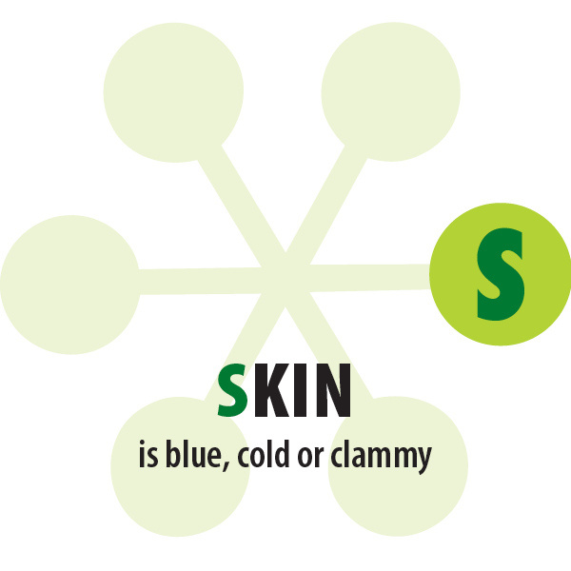
States with Medical Amnesty Laws
(in red)
www.medicalamnesty.org
Notes:
Check out your state’s medical amnesty laws by going to www.medicalamnesty.org
Review your campus medical amnesty policies

Slide 15
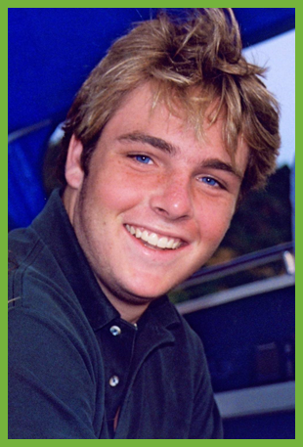
Be an ACTIVE Bystander!
Save a Life.
Make the Call.

Slide 16
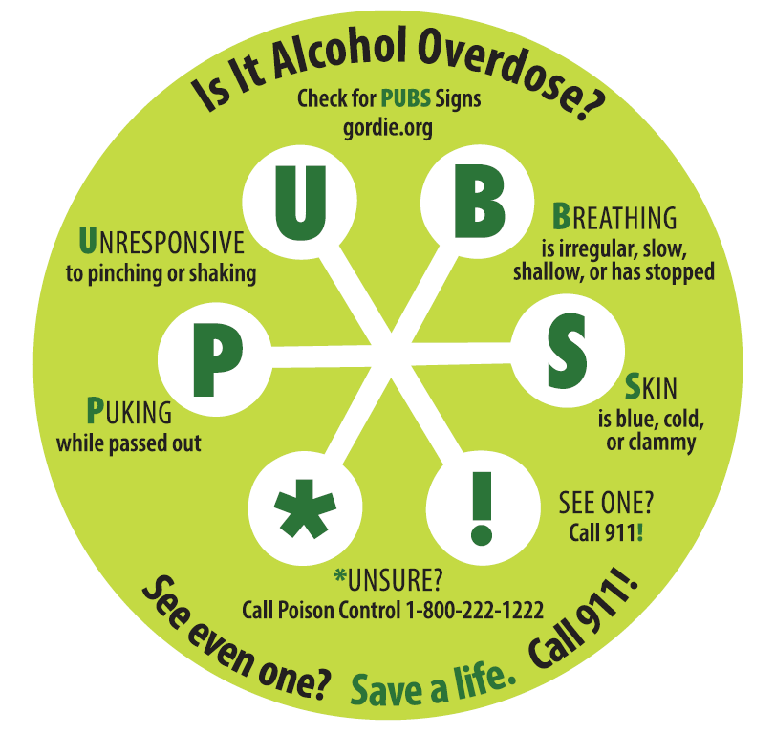
Take the Pledge to Check
Will you…
check for PUBS signs,
call 911 if even ONE sign is present, and
encourage others to learn PUBS?
Be a voice for someone who may not have one.
©2014-2022 Rector and Visitors of the University of Virginia and its Gordie Center. This image or any portion thereof may not be reproduced without written permission.
Notes:
We’ve thrown a lot of information at you, so just to reiterate—learn the PUBS signs of alcohol overdose.
Once you do, you can visit our website to sign our Pledge to Check, meaning that you know the signs and will call if you see even one.
You can also visit our website to see more of the videos that we have created about alcohol and about hazing—we encourage you to use our tools!

Slide 17
Q&A
The Gordie Center
www.gordie.org
Notes:
The Gordie Center offers free resources, such as the videos you have seen in this presentation, on their website: www.gordie.org.

